Slide 1
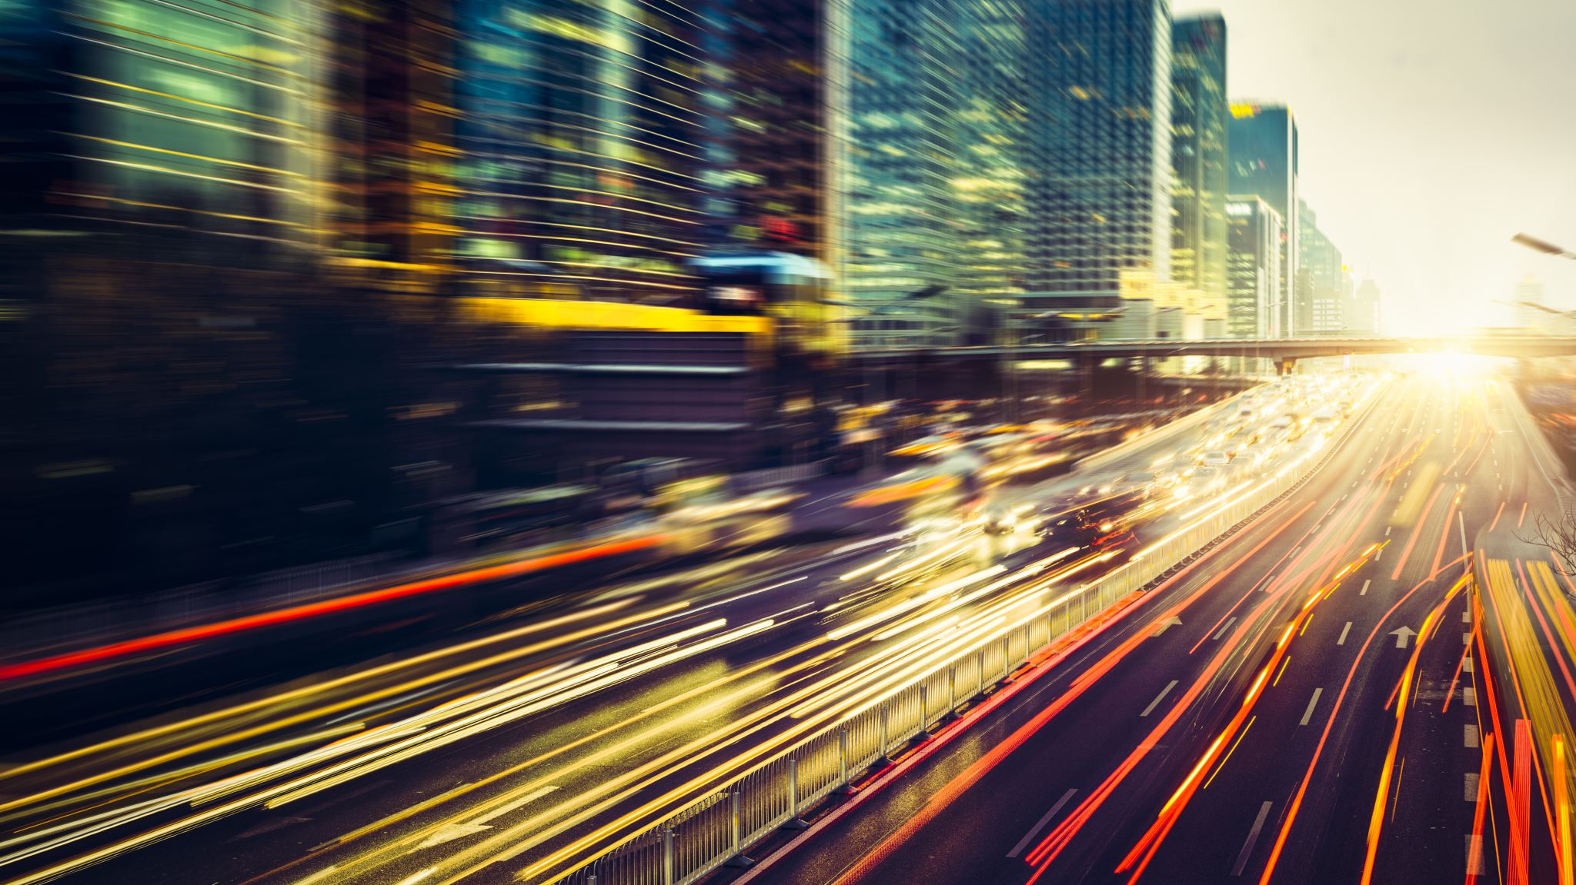
Los Angeles Traffic Collision Analysis
IST 652 SCRIPTING FOR DATA ANALYSIS
Prasad Kulkarni
Sathish Kumar Rajendiran

Slide 2
Summary
Project goals
Data sources
Data cleansing – structed and unstructured
Data Analysis
Conclusion

Slide 3
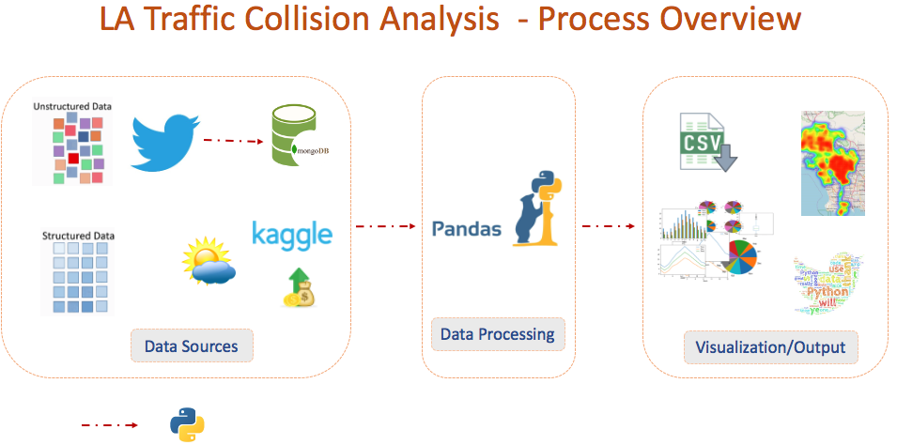

Slide 4
Project Goals
As the second largest city in the United States, Los Angeles has traffic challenges due to a large and growing population and an increase in the number of cars. A better understanding of the factors that contribute to accidents can help government officials, companies, citizens and other interested parties to understand how to make the city safer and more drivable.
The goal is to explore the trends and correlations between the data to provide useful information that can help answer our proposed analysis questions:
What are the most dangerous intersections?
What are the most common collision areas in Los Angeles?
What are the best/worst times of the day for accidents? Best/worst month?
What is the demographic makeup of victims in collisions?
What is the relationship between income and collision victims? Do certain temperatures or weather play a factor?
In 2018, at least 240 people were killed in Los Angeles traffic collisions. Despite programs designed to help reduce these collisions, fatal car crashes have increased 32% in Los Angeles since 2015 and more people have died in car crashes than shootings in that same timeframe. Many layers and factors exist for these traffic collisions.

Slide 5
Data Sources
Structured Data:
Original dataset
The Los Angeles Traffic Collision dataset available on Kaggle.com. It contains 481,568 incidents from 2010 to 2019. Analysis was limited to using 2017 & 2018 data based on volume.
(Area Name, Time, Victim Age, Victim Sex, Victim Descent, Premise, Address, Cross St, Coordinates, Zip Code)
Median income dataset
Incomes for Council Districts from 2016 were pulled from LA Chamber of Commerce website.
Council district was found to be the most effective way to merge income with rest of the data.
(Council district, Median Income)
Weather dataset
The weather data was scraped from the website Wunderground.com.
Once in CSV form, each weather CSV contained 359 rows and 7 columns
(Date, HighTemp, LowTemp, AverageTemp, Precipitation, NauticalTwilight, NauticalTwilightSet).
Unstructured data:
Unstructured data from Twitter API. GetOldTweets3 API pulled more than 252k tweets from 2010 to 2019 with search words including #latraffic and imported into MongoDB.
(Date, UserID, UserName, retweets, mentions, hashtags and text)

Slide 6
Data Cleansing for Structured vs Unstructured Data
Structured Data:
The Median Income dataset was cleaned by doing string replace to remove the commas in the numbers and to take away the $ characters. It was also converted to float data type. After it was cleaned, it was ‘inner’ merged on the column Council Districts with the LA dataset.
The Weather datasets for 2017 and 2018 were concatenated first to make a combined dataset. The weather data was converted to DateTime format, and then ‘inner’ merged with the LA dataset on the column Date.
The different data types of each column were evaluated and converted to its desired type.
Columns that were not needed were then removed; Blank values and NAs were removed with the dropna() function.
LA weather data from 2017-2019 was then merged with the traffic data set in a new LAWeather dataset
After everything was merged and cleaned, a data dictionary was created. The final LA collision dataset for analysis had 90,855 rows and 19 columns.
Unstructured Data:
Lists, Dictionaries and Pandas data frames for processing
Data type conversion & Derived calendar items
Removed special characters, change to lower case
Remove NAs
Removed redundant or unnecessary columns
Rearranging/Rename columns for ease of analysis
Filtered dataframe for 2017 and 2018 time/date analysis
Preprocessing API is used to clean Text with special characters for tokenization.
Write to file – export the file into CSV for validation.

Slide 7
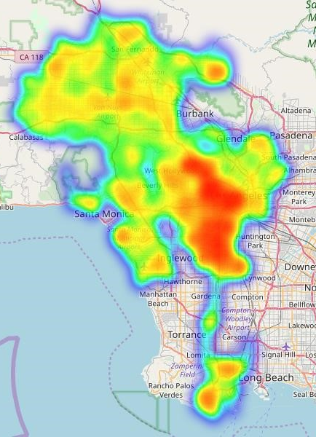
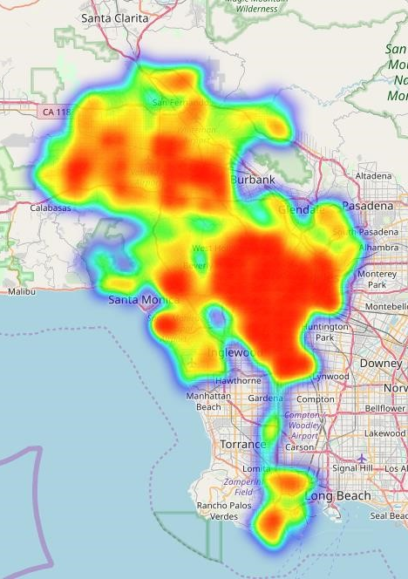
Location Analysis
These three heatmaps highlight how the center of LA has the most crashes at all times of the day.
The map of crashes when it is visibly dark shows the northern part of LA has less accidents at night.
Heat map of crashes before sunrise and after sunset
Heat map of crashes between sunrise and sunset

Slide 8
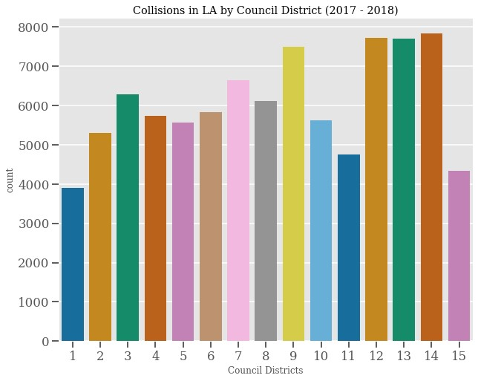
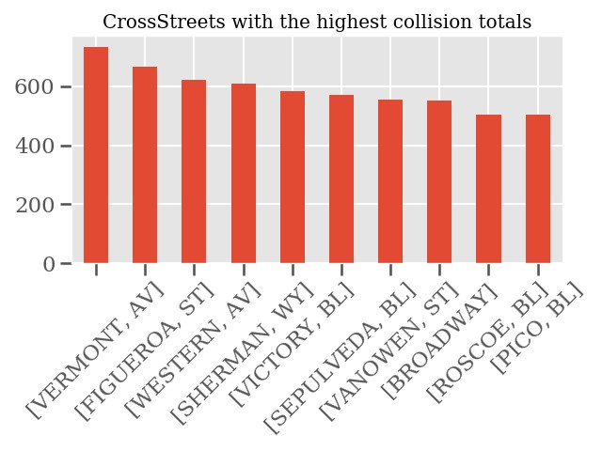
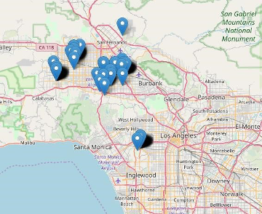
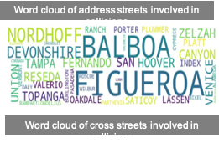
Location Analysis
The middle of the city has a similar density of collisions during at all times, at night, and during the day.
When it is dark there are fewer collisions in the northern area compared to the daytime.
The center of Los Angeles had the heaviest concentration of crashes but, the northern area had a handful of locations with more collisions than anywhere where else.
Council Districts with the most collisions: 12/13/14.
Cross Streets with the most collisions:
SEPULVEDA BL & SHERMAN WY
NORDHOFF ST & TAMPA AV
WHITSETT AV & SHERMAN WY
RODEO RD & LA BREA AV

Slide 9
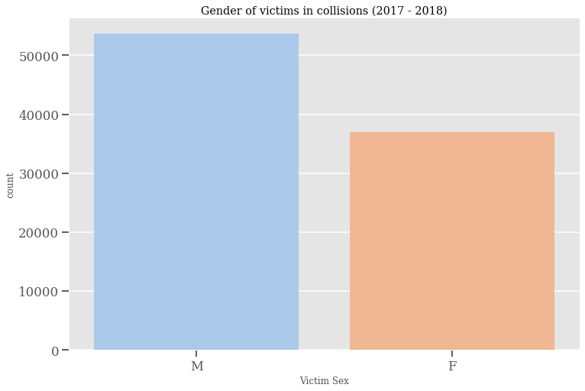
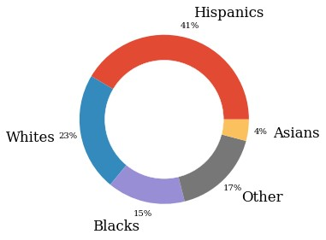
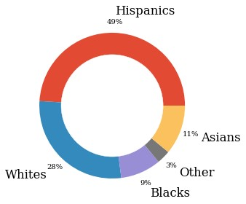
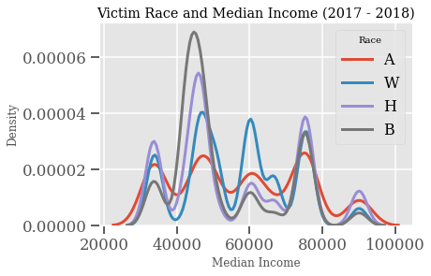
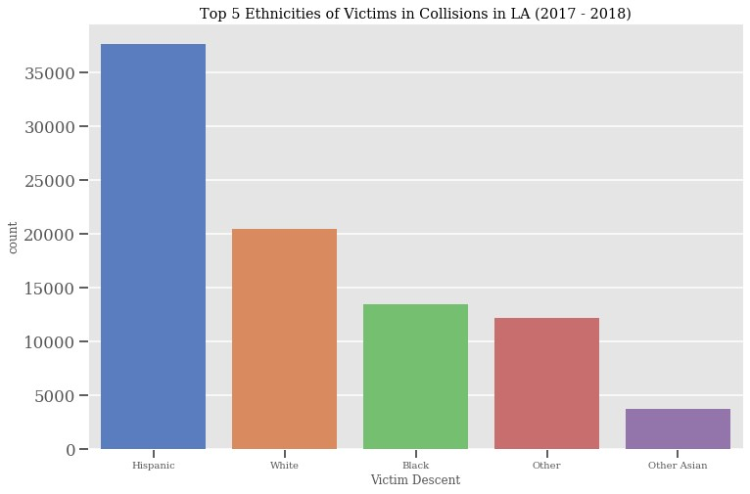
Demographics Analysis
Certain ages, genders, and ethnicities make an individual more susceptible to becoming a victim of a car collision.
Victim genders, ethnicity, age, race and income were analyzed.
Men are more likely to be in an accident compared to women.
Frequency of collisions is proportional to race/ethnicity’s population.
Age 30 has the highest number of collisions and the top 5 ages are all below 30.
34.08% of accident victims have a median income between $40-49K
Collision ethnicities (left) and la population ethnicities (right)

Slide 10
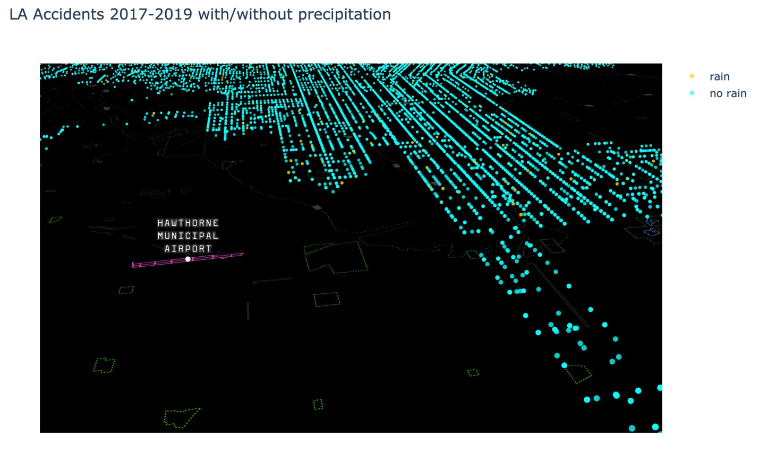
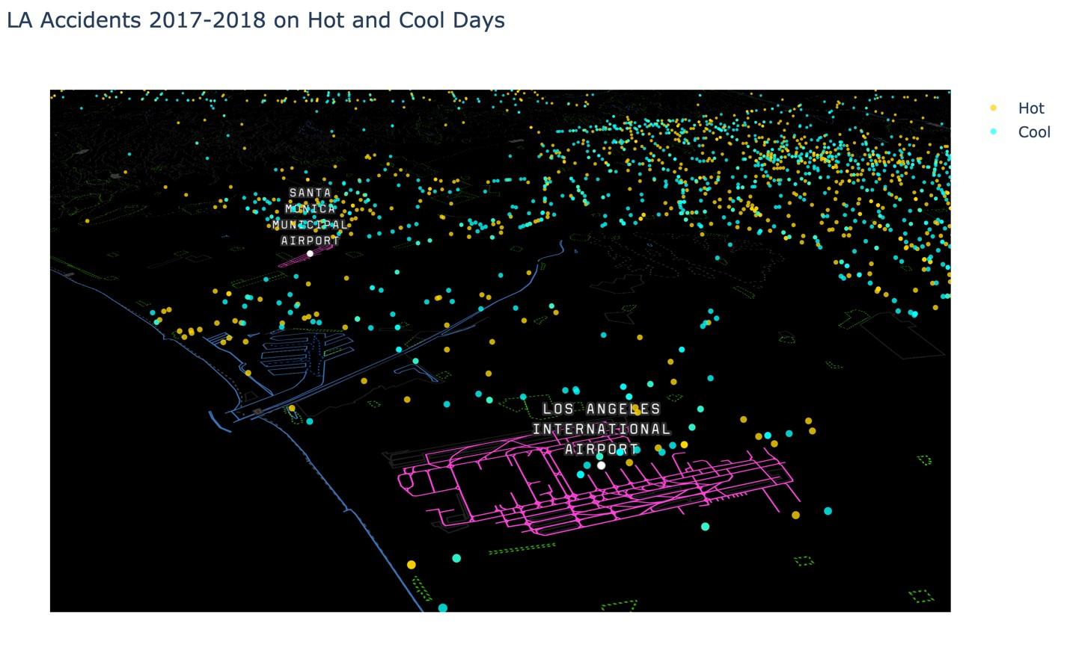
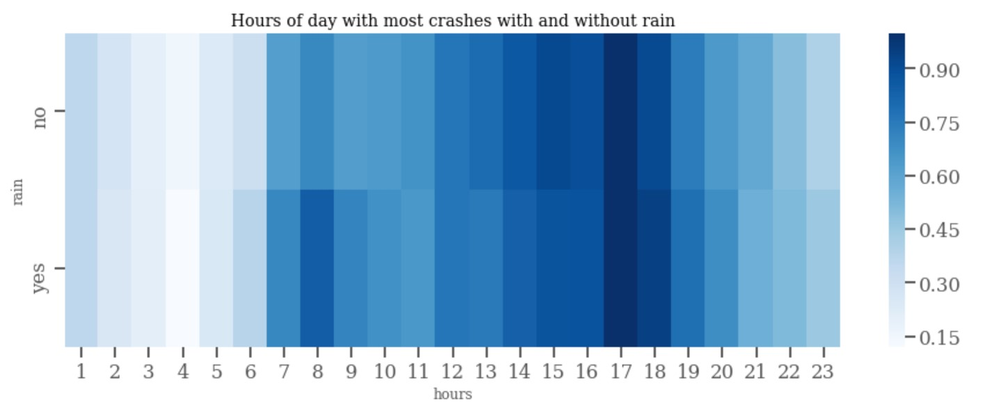
Weather Analysis
Los Angeles benefits from having great weather most of the time and weather is not a major factor as in other "wetter" cities. However, when it rains during evening rush hour traffic, there is an increase in the number of collisions.

Slide 11
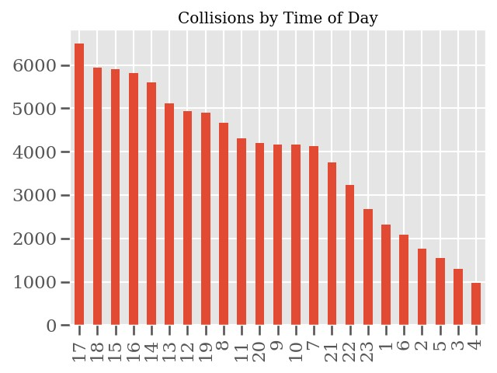
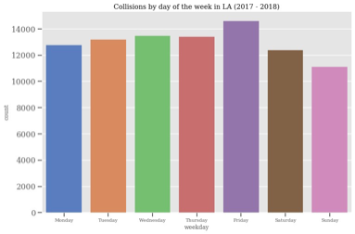
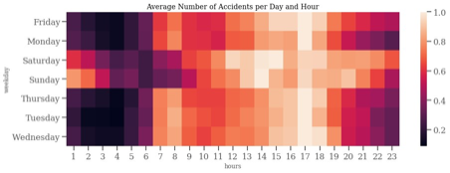
Time/ Day Analysis
The months have some variability, but some patterns are more obvious collisions have a cycle on the line charts.
Trends occur by day of the week. On Sunday they are the lowest. Then increase on Monday, Tuesday, and Wednesday. Thursday's are slightly lower on average, then Crashes Peak.
The highest frequency of accidents is on Monday-Friday between 4-5pm

Slide 12
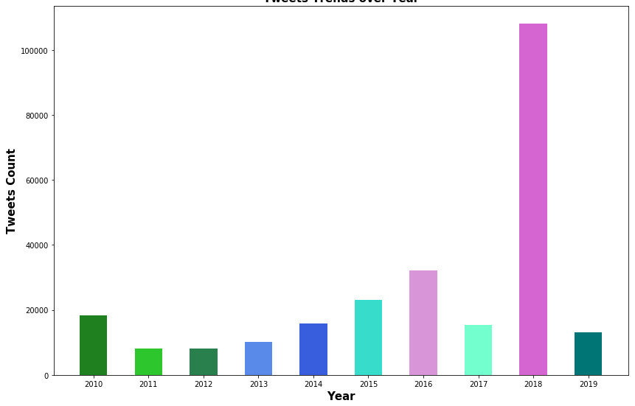
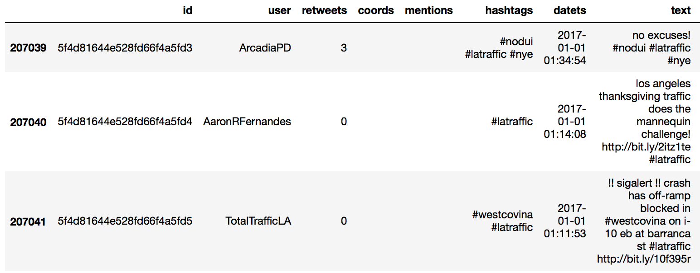
Unstructured Data (Tweets) Analysis
Over 250k tweets collected between 2010 to 2019
Tweets filtered on keywords such as #losangeles, #latraffic, #lapd, #lafd etc.
Friday has the highest volume of tweets/collisions; Sunday being the least.
Trends show that between 15 to 18h remains peak tweet/collision hours; 10 AM being the least.
TrafficLA user with more tweets followed by RMRealtor and LATrafficInfo users
Year 2017 had consistent tweets all through with December slightly higher than January and March

Slide 13
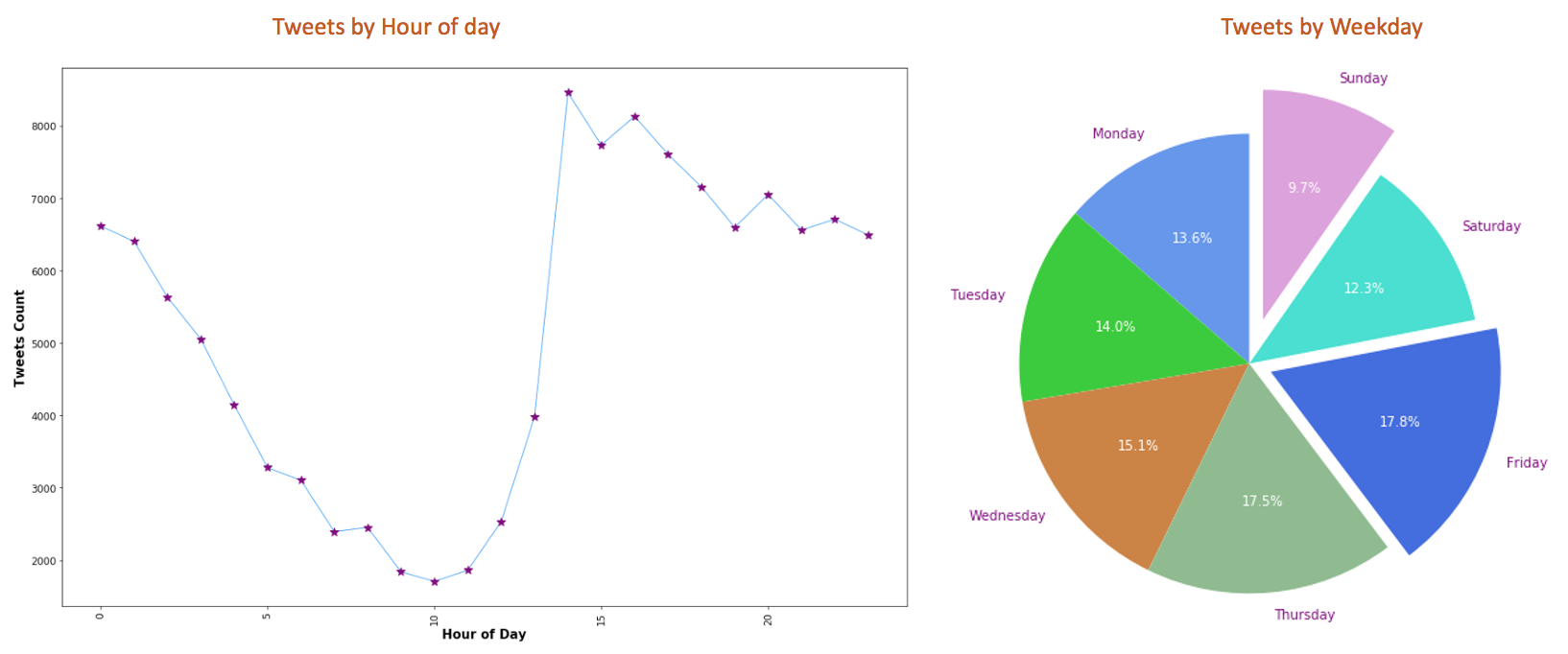
Tweets (Collisions) Analysis 2017-2018

Slide 14
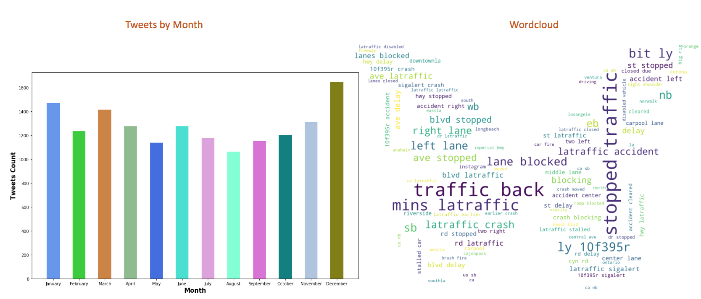
Tweets (Collisions) Analysis - 2017

Slide 15
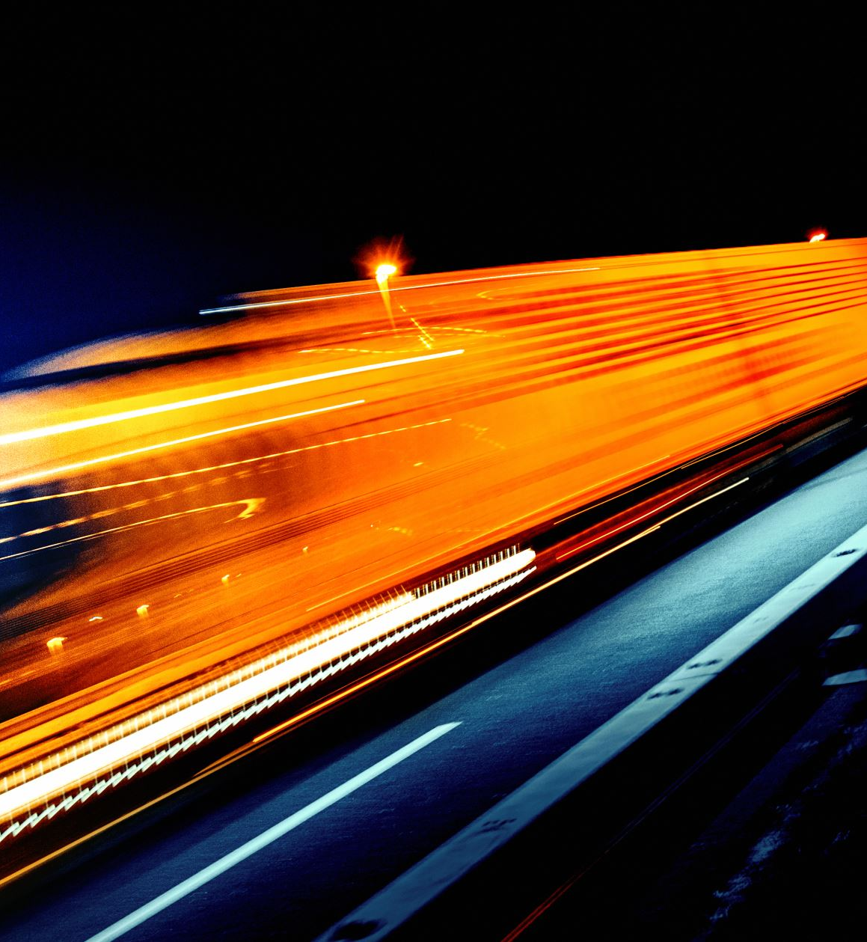
Conclusion
What is the most dangerous intersections?
SEPULVEDA BL & SHERMAN WY
What are the most common collision areas in Los Angeles?
77th Street Area
Council Districts 12/13/14
What are the best / worst times of the day for accidents? Best/worst month?
Friday has the highest frequency of collisions.
Sunday has the fewest amount of collisions.
March and October have the highest number of collisions.
The hours between 12PM to 5PM have the highest frequencies of collisions.
What is the demographic makeup of victims in collisions?
Men are more likely to be in an accident compared to women.
Frequency of collisions is proportional to race/ethnicity.
Age 30 has the highest number of collisions.
34.08% of accident victims have a median income between $40-49K.

